Slide 1
PROJECT INT. 7
Student: Bryan Solano
Teacher: Mirko Urdanivia

Slide 2
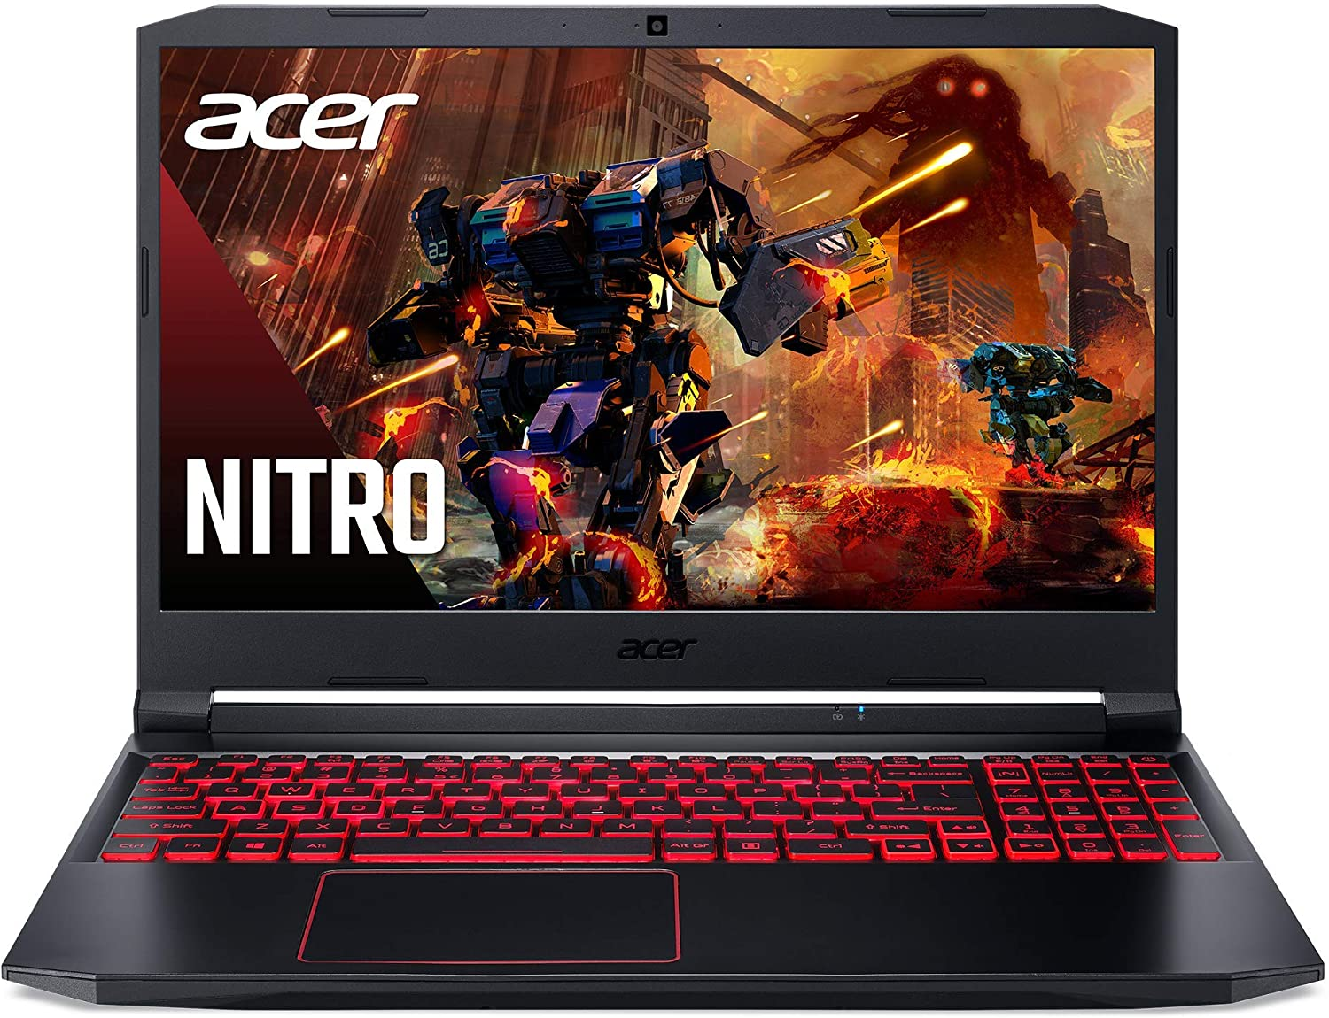
MOST PRECIOUS OBJETC

